Slide 1






Predicting Credit Card Approvals
Using Machine Learning
VK

Slide 2


Problem Statement:
The primary objective of this project is to predict
the approval or rejection of credit card applications.
The challenge lies in understanding the key factors influencing
credit card approval decisions and
building a predictive model to assist in
the decision-making process.
VK

Slide 3
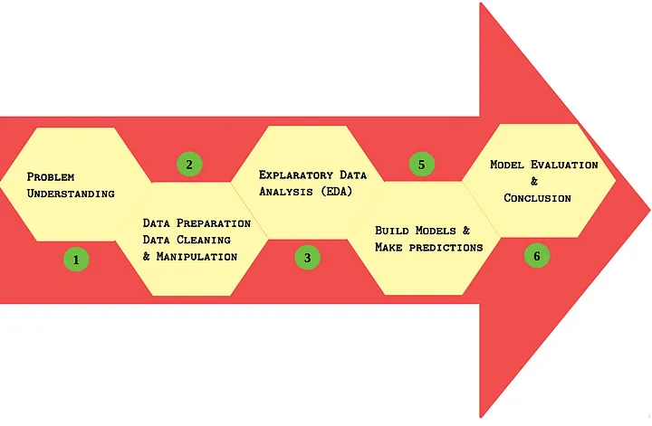
Project Tasks
VK

Slide 4


Import Python Libraries
VK

Slide 5
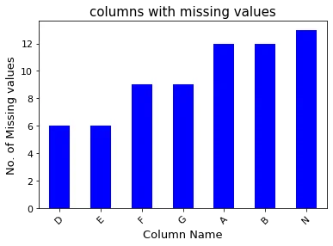
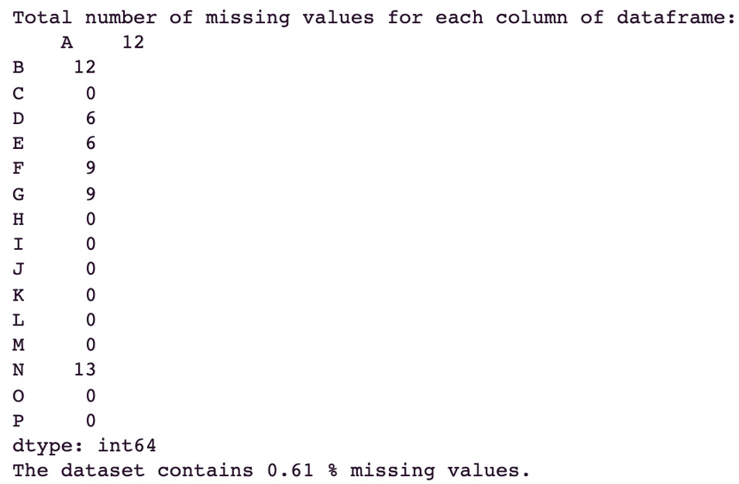
Handling the missing values:
The table on left shows the column name and the corresponding number of missing values. The bar plot on the right visualizes the columns with non-zero missing values.
VK

Slide 6
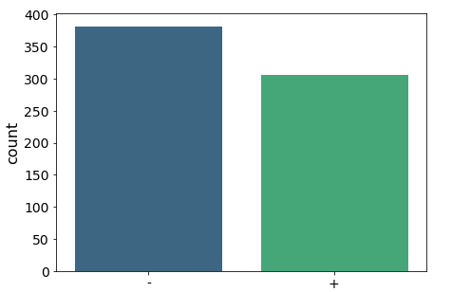
Preprocessing the data
Let’s visualize the target variable and have a look at how many approved and declined applications are there in our dataset.
383 (55.5%)
307 (44.5%)
VK

Slide 7
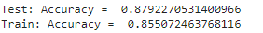
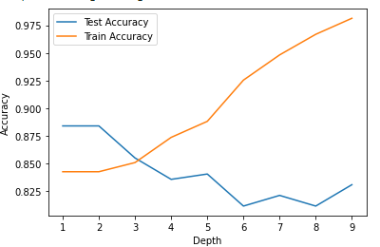

Machine Learning Classifiers
a) Logistic Regression:
b) Decision Tree
Test accuracy 85.5 %.
VK

Slide 8
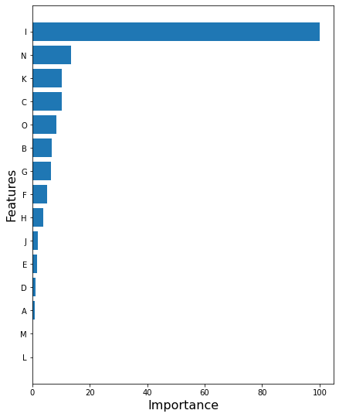
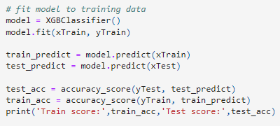

C) Gradient Boost
D) XGBoost
Train score: 1.0
Test score: 0.8743961352657005
Train score: 98.1%
Test score: 87%
VK

Slide 9
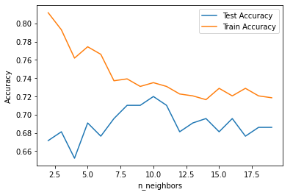
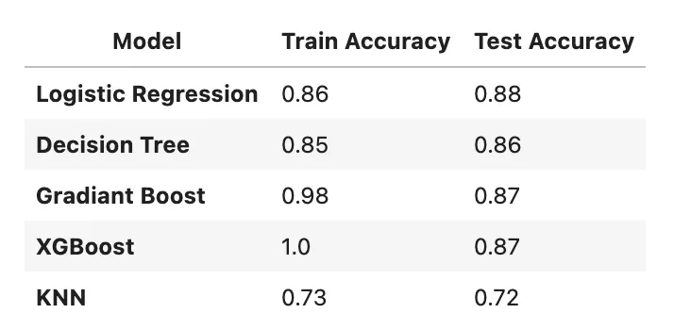
E) KNN
Conclusion:
Train score: 0.7184265010351967
Test score: 0.6859903381642513
VK

Slide 10
"Thank you for your time"
-Varun Kumar
VK

